Slide 1
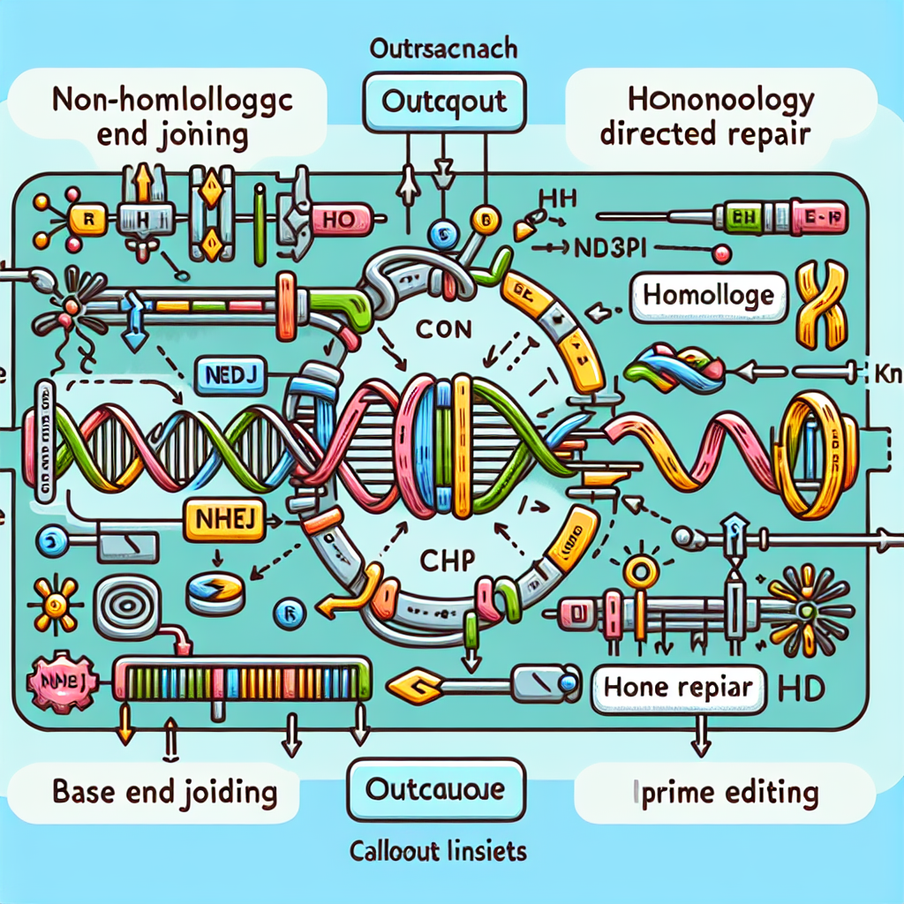
How CRISPR Works
Diagram Layers
Target selection: Cas9 scans DNA for a PAM (e.g., NGG) and the 20-nt guide RNA (gRNA) base‑pairs with the protospacer.
Cutting: Cas9’s HNH and RuvC domains cleave opposite strands to create a double‑strand break (DSB).
Repair path A—NHEJ: Error‑prone repair introduces small indels, often yielding gene knockout.
Repair path B—HDR: With a donor template, precise edits/insertions are made at the break site.
Glossary
gRNA: Guide RNA that directs the nuclease to a matching DNA sequence
PAM: Protospacer Adjacent Motif required for nuclease binding (e.g., NGG for SpCas9)
RNP: Ribonucleoprotein complex of Cas protein and gRNA, used for transient editing
Editor Variants
Base editors (ABE/CBE): nCas9 or dCas9 fused to a deaminase; single‑base conversions (A↔G, C↔T) without DSB.
Prime editor: nCas9 fused to reverse transcriptase with a pegRNA; installs small insertions/deletions/substitutions with minimal cutting.

